Slide 1

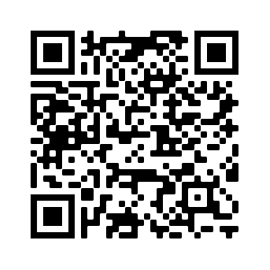

Welcome to…
Please follow the link or use the QR code to get the latest updates for this tutorial!
David E. Bernholdt, Anshu Dubey, Patricia Grubel, Rinku Gupta
Assisted by Deborah Stevens
2:30pm-6:30pm ET Tuesday 10 November 2020
Last-minute updates, final slides, etc. at: https://betterscientificsoftware.github.io/bssw-tutorial-sc20/
See slide 2 for license details and requested citation

Slide 2
License, Citation and Acknowledgements
License and Citation
This work is licensed under a Creative Commons Attribution 4.0 International License (CC BY 4.0).
The requested citation the overall tutorial is: David E. Bernholdt, Anshu Dubey, Patricia A. Grubel, Rinku K. Gupta, Better Scientific Software tutorial, in SC ‘20: International Conference for High Performance Computing, Networking, Storage and Analysis, online, 2020. DOI: 10.6084/m9.figshare.12994376
Individual modules may be cited as Speaker, Module Title, in Better Scientific Software tutorial…
Acknowledgements
Additional contributors include: Mike Heroux, Alicia Klinvex, Mark Miller, Jared O’Neal, Katherine Riley, David Rogers, Deborah Stevens, James Willenbring
This work was supported by the U.S. Department of Energy Office of Science, Office of Advanced Scientific Computing Research (ASCR), and by the Exascale Computing Project (17-SC-20-SC), a collaborative effort of the U.S. Department of Energy Office of Science and the National Nuclear Security Administration.
This work was performed in part at the Argonne National Laboratory, which is managed by UChicago Argonne, LLC for the U.S. Department of Energy under Contract No. DE-AC02-06CH11357.
This work was performed in part at the Oak Ridge National Laboratory, which is managed by UT-Battelle, LLC for the U.S. Department of Energy under Contract No. DE-AC05-00OR22725.
This work was performed in part at the Lawrence Livermore National Laboratory, which is managed by Lawrence Livermore National Security, LLC for the U.S. Department of Energy under Contract No. DE-AC52-07NA27344.
This work was performed in part at the Los Alamos National Laboratory, which is managed by Triad National Security, LLC for the U.S. Department of Energy under Contract No.89233218CNA000001
This work was performed in part at Sandia National Laboratories. Sandia National Laboratories is a multi-mission laboratory managed and operated by National Technology and Engineering Solutions of Sandia, LLC., a wholly owned subsidiary of Honeywell International, Inc., for the U.S. Department of Energy’s National Nuclear Security Administration under contract DE-NA0003525.

Slide 3
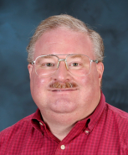
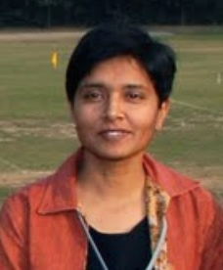
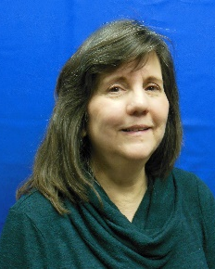
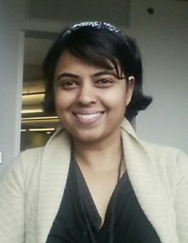
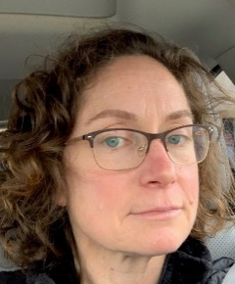
About Us
David Bernholdt, ORNL
Anshu Dubey, ANL
Patricia Grubel, LANL
Rinku Gupta, ANL
With help from: Deborah Stevens, ANL
Member of the IDEAS Productivity Project: http://ideas-productivity.org
Focus: Increasing CSE software productivity, quality, and sustainability
David
Anshu
Patricia
Rinku
Deborah

Slide 4
The IDEAS-ECP team works with the ECP community to improve developer productivity and software sustainability as key aspects of increasing overall scientific productivity
Establish software communities
Determine community policies to improve software quality and compatibility
Create Software Development Kits (SDKs) to facilitate the combined use of complementary libraries and tools
1
Customize and curate methodologies
Target scientific software productivity and sustainability
Use workflow for best practices content development
3
Incrementally and iteratively improve software practices
Determine high-priority topics for improvement and track progress
Productivity and Sustainability Improvement Planning (PSIP)
Engage in community outreach
Broad community partnerships
Collaboration with computing facilities
Webinars, tutorials, events
WhatIs and HowTo docs
Better Scientific Software site (https://bssw.io)
2
4

Slide 5
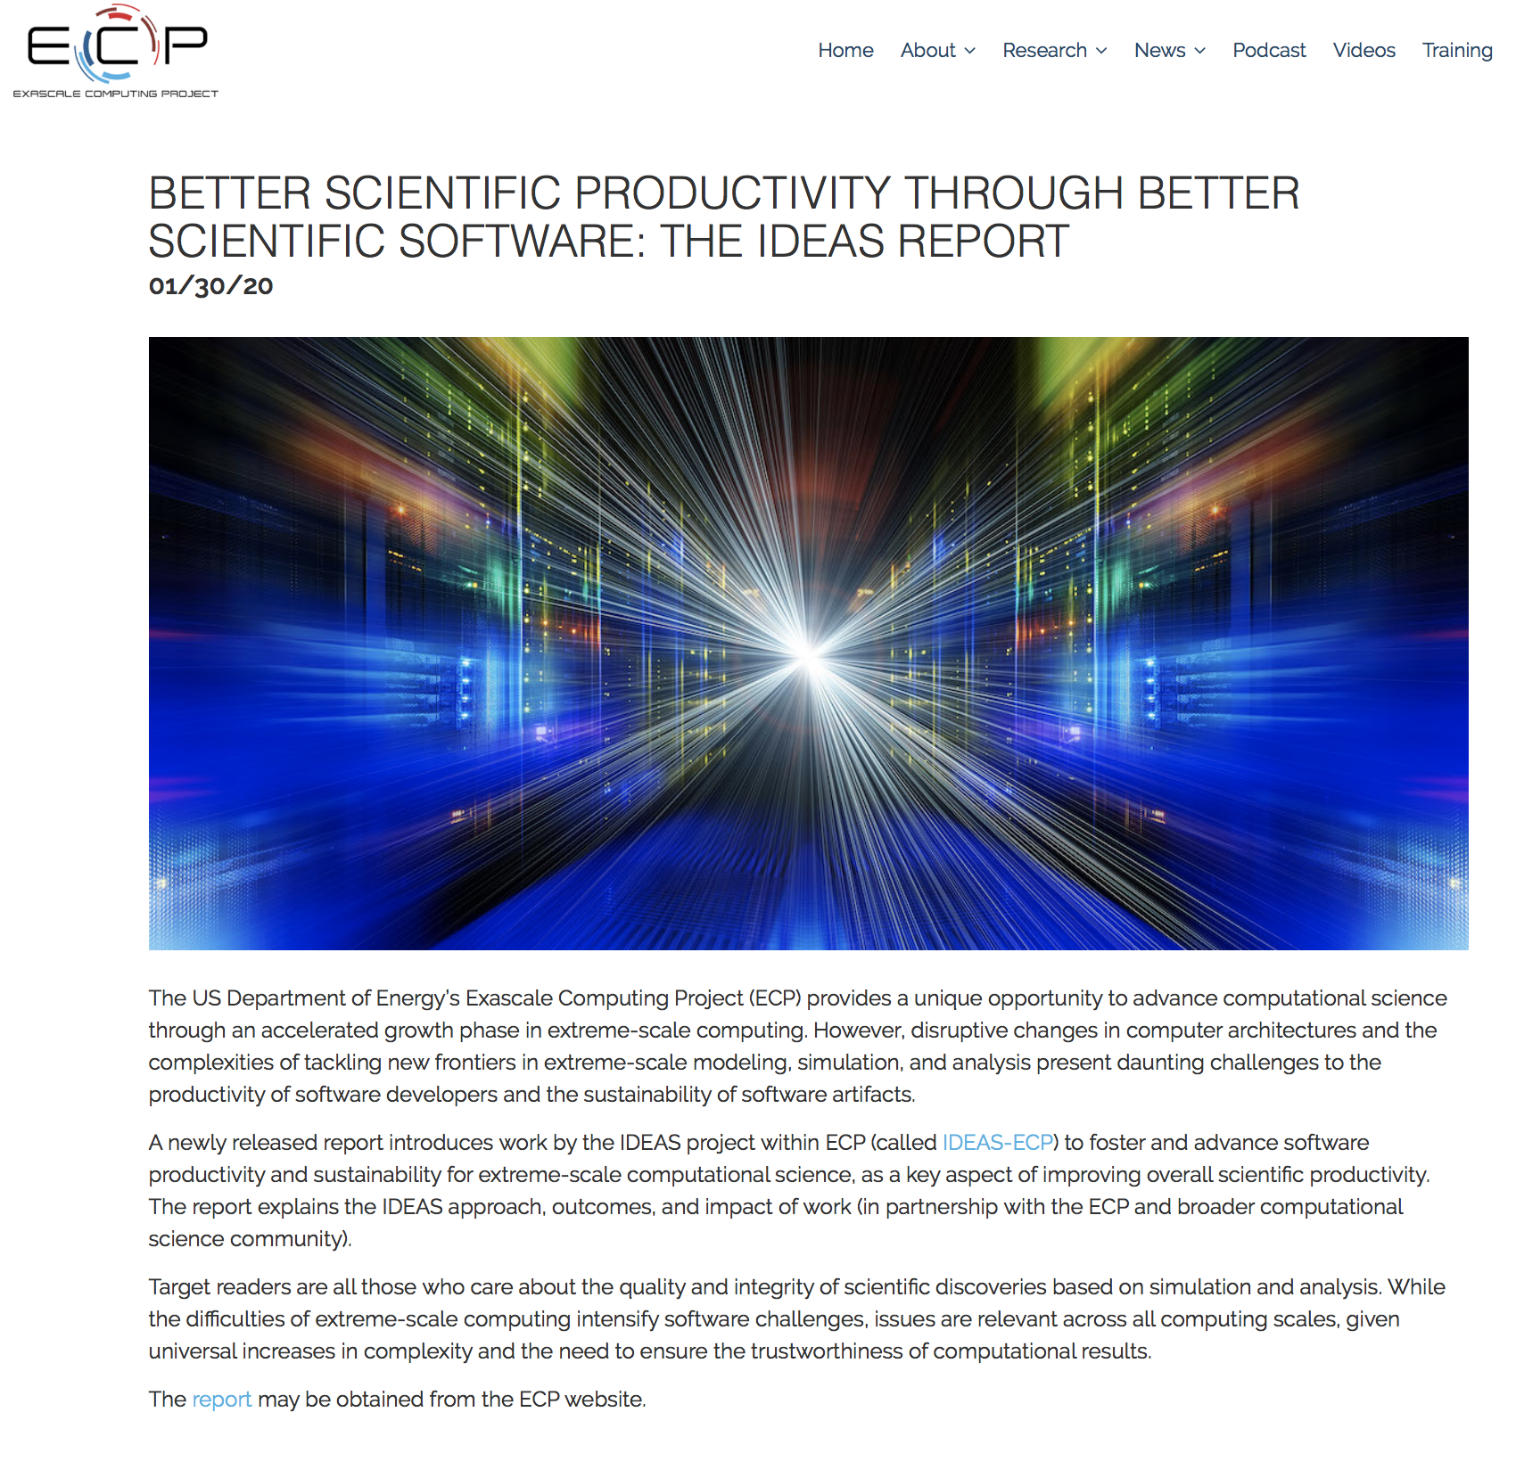
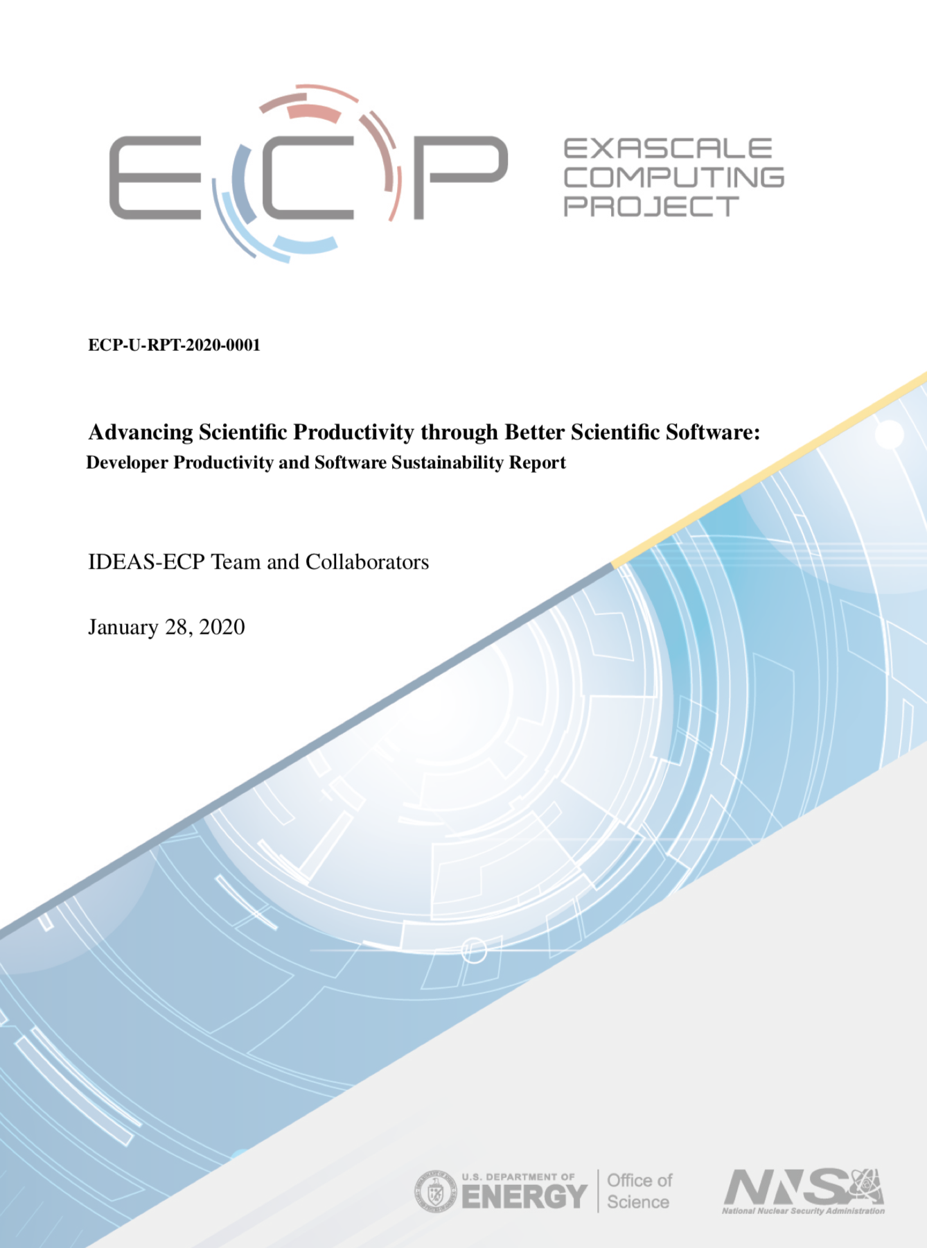
Advancing Scientific Productivity through Better Scientific Software: Developer Productivity and Software Sustainability Report
Disruptive changes in computer architectures and the complexities of tackling new frontiers in extreme-scale modeling, simulation, and analysis present daunting challenges to software productivity and sustainability.
This newly released report explains the IDEAS approach, outcomes, and impact of work (in partnership with the ECP and broader computational science community).
Target readers are all those who care about the quality and integrity of scientific discoveries based on simulation and analysis. While the difficulties of extreme-scale computing intensify software challenges, issues are relevant across all computing scales, given universal increases in complexity and the need to ensure the trustworthiness of computational results.
January 2020
https://exascaleproject.org/better-scientific-productivity-through-better-scientific-software-the-ideas-report

Slide 6

Building an Online Community
https://bssw.io
New community-based resource for scientific software improvement
A central hub for sharing information on practices, techniques, experiences, and tools to improve developer productivity and software sustainability for computational science & engineering (CSE)
Goals
Raise awareness of the importance of good software practices to scientific productivity and to the quality and reliability of computationally-based scientific results
Raise awareness of the increasing challenges facing CSE software developers as high-end computing heads to extreme scales
Help CSE researchers increase effectiveness as well as leverage and impact
Facilitate CSE collaboration via software in order to advance scientific discoveries
Site users can…
Find information on scientific software topics
Contribute new resources based on your experiences
Create content tailored to the unique needs and perspectives of a focused scientific domain

Slide 7


Follow IDEAS and BSSw
IDEAS Productivity mailing list: http://eepurl.com/cQCyJ5
Announcements of IDEAS-organized events
Best Practices for HPC Software Developers webinar series
Strategies for Working Remotely panel series
Major scientific meetings (e.g., SIAM, ISC, SC, etc.)
Typically 2-3 messages per month
BSSw Digest: https://bssw.io/pages/receive-our-email-digest
Updates on BSSw content
New blog posts, events, and resources
BSSw Fellowship
Typically 1-2 messages per month
Also: RSS feed: https://bssw.io/items.rss

Slide 8
Additional Software-Related Events at SC20
Day/Time | Event Type | Event Title (and Link for Details)
Monday, Nov. 9 10:00am-2:00pm ET | Tutorial | Managing HPC Software Complexity with Spack: Part 1
Tuesday, Nov. 10 10:00am-2:00pm ET | Tutorial | Managing HPC Software Complexity with Spack: Part 2
Wednesday, Nov. 11 10:00am-6:30pm ET | Workshop | Seventh SC Workshop on Best Practices for HPC Training and Education
Wednesday, Nov. 11 2:30pm-6:30pm ET | Workshop | Correctness 2020: 4th International Workshop on Software Correctness for HPC Applications
Thursday, Nov. 12 10:00am-1:00pm ET | Workshop | RSE-HPC-2020: Research Software Engineers in HPC
Friday, Nov. 13 10:00am-6:10pm ET | Workshop | EduHPC20: Workshop on Education for High-Performance Computing
Friday, Nov. 13 10:00am-6:10pm ET | Workshop | P3HPC: 3rd International Workshop on Performance Portability and Productivity
Tuesday, Nov. 17 3:30pm-4:30pm ET | State of the Practice | Responding to Pandemic Driven Change
Wed., Nov. 18 11:30am-12:45pm ET | BOF | Spack Community BOF (TP or XO registration required; XO available for free)
Thursday, Nov. 19 2:30pm-3:45pm ET | BOF | Software Engineering and Reuse in Modeling, Simulation, and Data Analytics for Science and Engineering (TP or XO registration required; XO available for free)

Slide 9
Tutorial Objectives
Overview of best practices in software engineering explicitly tailored for CSE
Why: Increase CSE software quality, sustainability, productivity
Better CSE software > better CSE research > broader CSE impact
Who: Practices relevant for projects of all sizes
emphasis on small teams, e.g., a faculty member and collaborating students
Approach:
Useful information, examples, exercises, pointers to other resources
Not to prescribe any particular practices as “must use”
Be informative about practices that have worked for some projects
Recommend a series of small, incremental improvements
Emphasize adoption of practices that help productivity rather than put unsustainable burden
Customize as needed for each project
Remember: your code will live longer than you expect. Prepare for it!
Old Process
New Process
Cost
Start
Progress
Finish

Slide 10
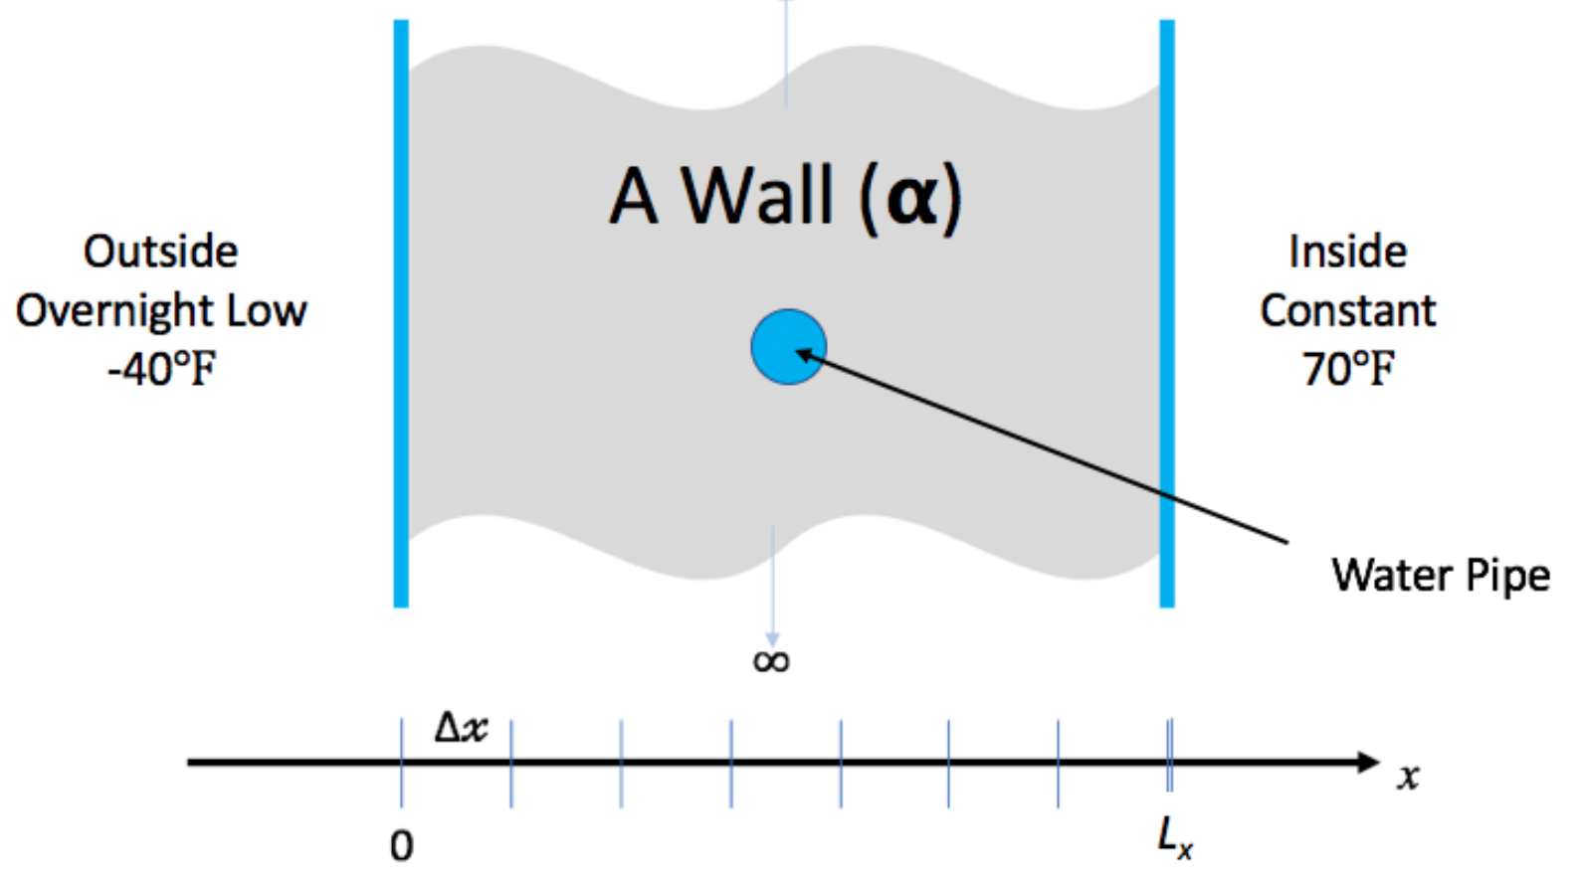
Hands-On Activities
We have created a simple example to give you some (optional) hands-on experience with some of the concepts in this tutorial
You don’t need to understand the math/physics to do the exercises, or find them useful
Because of the limited time for this tutorial, the exercises will be “homework”, but we’ll be happy to give you feedback on your work
We will demonstrate a few things during breaks in today’s tutorial (participation optional)
Instructions on the tutorial web site: https://betterscientificsoftware.github.io/bssw-tutorial-sc20/

Slide 11
Handling Questions and Discussion
The main presentations have been pre-recorded
Please use the question channel to ask questions during the presentations and the live segments. The speaker and the rest of the tutorial team will be monitoring and will respond
We will also keep an eye on the chat channel, but that’s more for extended follow-on discussions
During the breaks, we will be available for live Q&A (also via questions/chat) and will provide some live demos of concepts in the hands-on exercises
Participation is optional – we know you need breaks too
Please complete an evaluation of this tutorial
Evaluation link is in the tutorial info page on the EventScribe web site
After the tutorial, you’ll continue to have access to the recording…
…and we’ll be around too – email us at bssw-tutorial@lists.mcs.anl.gov
The list moderator will allow your messages to be posted

